Slide 1
Webinar Series
5 Oct 2016: 07:00AM UTC/GMT
A framework for Transforming Assessment in Higher Education
Presenter:
Dr Sam Elkington (Higher Education Academy, UK)
Your Webinar Hosts
Professor Geoff Crisp, PVC Education, University of New South Wales
g.crisp[at]unsw.edu.au
Dr Mathew Hillier, Office of the Vice-Provost Learning & Teaching, Monash University
mathew.hillier[at]monash.edu
Just to let you know:
By participating in the webinar you acknowledge and agree that:
The session may be recorded, including voice and text chat communications (a recording indicator is shown inside the webinar room when this is the case).
We may release recordings freely to the public which become part of the public record.
We may use session recordings for quality improvement, or as part of further research and publications.
e-Assessment SIG

Slide 2
Transforming Assessment in Higher Education
Dr. Sam Elkington, Academic Lead for Assessment and Feedback

Slide 3
Assessment in Context
Assessment practices have not kept pace with shifts in the context, aims and structure of contemporary HE
Assessment can no longer do justice to the outcomes expected from a university education in relation to wide-ranging knowledge, skills and employability
Modularisation of university programmes has lead to growth in summative assessment and a concomitant strain on resources
Tutor-student ratios have gradually been eroded leading to confusion for students over what is expected of them in assessment

Slide 4
Assessment in Context
‘Time-on-task’ has been sacrificed for the sake of coverage and certification of knowledge (Hattie, 2009)
Pressure to ensure assessment can mirror the demands of the workplace or lead to skills that are relevant for a range of ‘real-world’ activities (Rowe et al. 2014)
A need to re-establish standards rather than measurements and grades and return to a focus on students as learners
Requires an alternative ‘Participation’ metaphor of learning

Slide 5
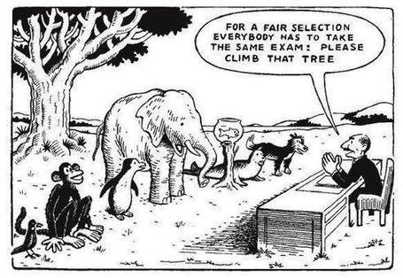

Slide 6
Let us start with Learning excellence
Fiona Saunders (2015) Innovative assessment still needs to be effective
Meaningful assessment is one which supports the achievement of learning objectives
Equitable assessment is one for which the reward is proportional to the effort put in and the skills demonstrated, whether this is on an individual or group basis
Manageable assessment is one which can be completed and marked in a timely manner, without undue stress for staff or students.
Shifting from a ‘Product’ view to a ‘Process’ view of Assessment!

Slide 7
Let us start with Learning excellence
Sustainable Assessment
Need more authentic approaches which support the processes of learning that students need beyond the point of graduation (Sambell et al., 2013)
Learning must be integrative, lasting and the overall system of education must be coherent (Boud, 2000)
Does assessment do what we want it to do in terms of promoting the kind(s) of learning that are desired for the longer-term? (Boud et al., 2010)

Slide 8
Let us start with Learning excellence
Basic resources for sustainable assessment:
Confidence that new learning tasks can be mastered
Exploration of criteria and standards which apply to any given learning task
Active engagement with learning tasks with a view to testing understanding and application of criteria and standards
Developing devices for self-monitoring and judging progressions towards goals
Access to peers and others with expertise to reflect on challenges and gain support for renewed effort
Use feedback to influence new ways of engaging with the learning task

Slide 9
Let us start with Learning excellence
Active student participation in assessment is the only common variable to programmes and departments rated as ‘excellent’ with regards to learning, teaching and research (Price et al. 2011)
Learning Experience Triangles (LETS)
Creating 3-way partnerships between students, staff and external organisations
External partners bring forward a real problem for students to work on for mutual benefit

Slide 10
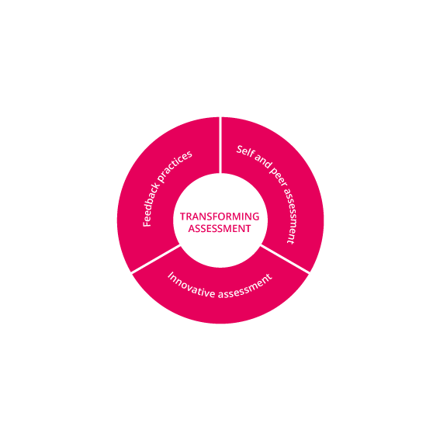
The student perspective
Learning-Oriented Assessment (Careless, 2015)
Learning-oriented assessment tasks that propel student engagement and approaches in learning
Student engagement with feedback processes to reduce the immediacy between standards and performance (Evans, 2013)
Developing evaluative expertise engaging students with quality and develop their self and inter-personal evaluative capabilities

Slide 11
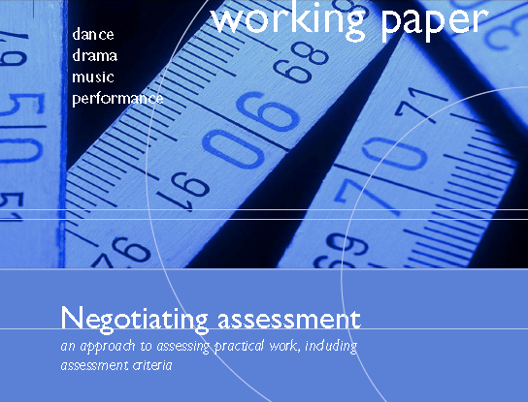
The student perspective
Injecting elements of choice into assessment means students are able to pursue topics in which they have a personal interest (Sambell et al. 2013) – shown to lead to a greater sense of ownership in student learning (Carless, 2015).
Negotiating Assessment
Assessment should operate and be perceived be an integral part of the learning process rather than 'bolted-on' to the end of that process.
The form, content and implementation of the assessment process should be commensurable with the discourse and practices of the field
Students positioned as agents in their own assessment rather than objects of assessment.

Slide 12
Some reflective questions
To what extent should assessments be related to real-life applications of your discipline?
Should assessment tasks be mainly individual to facilitate the award of a fair grade or is there a case for alternative forms of assessment?
What kinds of assessment manage the challenge of double duty well?

Slide 13
A case for change
Improved potential for student learning
Shifting balance of summative and formative assessment provides scope to use a more varied and effective range of assessment tools
Assessment for learning is formative and diagnostic enabling teaching and learning activities to be responsive to the needs of the learner (Bloxham, 2012)
Increased student satisfaction
1-3% improvement in assessment and feedback scores on NSS between 2008-2015.
Tutor-student dialogue is crucial in understanding assessment expectations and using feedback effectively

Slide 14
Improve value-added: maximise resources for learning
Shifting from summative to formative can reduce costs involved in processing student work and redirect academic resources toward learning
Inclusive assessment
Assessment takes on an important role in supporting and enabling all students to successfully demonstrate their achievements
Requires open-minded consideration of how the learning outcomes for a module/programme can be demonstrated
Assessment for a 21st century education
Majority of subject benchmarks and QA regs actively support the broadening of the curriculum to embrace a wider view of graduate capabilities

Slide 15
A dependable and fairer representation of student achievement
Marks are too often used formulaically artificially combining marks from different sources which do not have equal weighting, meaning or validity
Seek out opportunities to more effectively and consistently represent student achievement
Supporting academic integrity
Innovative assessment design essential to promoting academic integrity
Requires an holistic and integrated approach and more sophisticated assessment tasks

Slide 16
Putting assessment to work
“Patchwork Assessment”
‘The essence of a patchwork is that it consists of a variety of small sections, each of which is complete in itself, and that the overall unity of these component sections, although planned in advance, is finalized retrospectively, when they are ‘stitched together’ (Winter, 2003: 112).
Key features
Student-centred, inclusive, personalised and contextualised within the real world
Opens up to continuous formative feedback supported by peer engagement where students engage in meaningful feedback with each other
Bespoke learning underpins the process wherein the student chooses the pivotal learning moments
Articulation of experience is at the centre of the learning process

Slide 17
Some reflective questions
How do summative tasks you set help students develop their learning?
To what extent are marks the main incentive for student engagement in your module/programme?
What kinds of developmental (formative) activities are offered in your programme/module and how is this best achieved?
How does the range and mix of assessment activities on your programme capture the ‘distance travelled’ by students?

Slide 18
Feedback Unbound
A logical conundrum:
How to develop effective feedback processes within the constraints of time and resources

Slide 19
Rethinking models of feedback
Seeing feedback as ‘all dialogue to support learning in both formal and informal situations’ (Carless et al. 2011: 2)
‘A fundamental requirement of effective assessment is ‘to facilitate high-quality feedback exchanges’ (Boud and Lawson, 2011)
Feedback as a way of promoting learning through fostering active learners, not as individual acts of information provision and reception (Boud and Molloy, 2012)
“Sustainability” of feedback would ‘be a function of its contribution to equip students to learn prospectively, in their lives and careers beyond graduation’ (Hounsell, 2008)

Slide 20
Feedback – what students need
Characteristics of Sustainable Feedback (Boud and Molloy, 2012)
Involving students in dialogues about learning which raise their awareness of quality performance
Facilitating feedback processes through which students are stimulated to develop capacities in monitoring and evaluating their own learning
Enhancing student capacities for ongoing lifelong learning by supporting student development of skills for goal setting and planning their learning
Designing assessment tasks to facilitate student engagement over time in which feedback from varied sources is generated, processed and used to enhance performance on multiple stages of assignments.

Slide 21
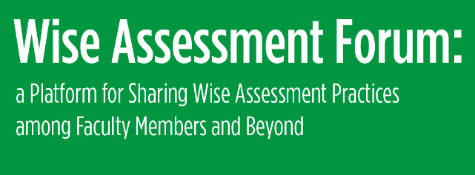
Reconceptualising Feedback
“Flipping Feedback”
Approaching the issue of engaging students with timely feedback by devising ways to give ‘feed-forward’, ‘real-time’ or ‘embedded feedback’
(University of Edinburgh, 2007, 2015)
“Feedback as Dialogue”
Strategies for reducing the burdens on teachers and to make students more active in generating and using feedback
(University of Hong Kong, 2015)

Slide 22
Reconceptualising Feedback
Developing Engagement with Feedback Toolkit (DEFT)
Asks – If we want students to engage with and utilise the feedback we provide, then what skills do they need, and how do we nurture these skills?
Developed to support educators and students to work together in partnership
Better reception and understanding of feedback information by students
(Winstone and Nash, 2016)

Slide 23
Some reflective questions
What opportunities are there for feedback dialogue (peer and/or teacher-learner) around assessment tasks on your module/programme?
To what extent are students given opportunity to act upon feedback – in what ways?
What kind of teacher feedback do you provide and in what ways does it help learners self-assess and self-correct?

Slide 24
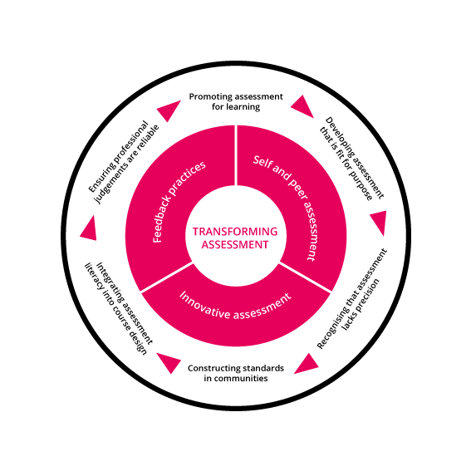
Tenets of Transforming Assessment
Tenet 1: Assessment for learning
The debate on standards needs to focus on how high standards of learning can be achieved through assessment. This requires a greater emphasis on assessment for learning rather than assessment of learning.
Tenet 2: Ensuring assessment is fit for purpose
When it comes to the assessment of learning, we need to move beyond systems focused on marks and grades towards the valid assessment of the achievement of intended programme outcomes.

Slide 25
Tenet 3: Recognise that assessment lacks precision
Limits to the extent that standards can be articulated explicitly must be recognised since ever more detailed specificity and striving for reliability, all too frequently, diminish the learning experience and threaten its validity.
There are important benefits of higher education which are not amenable either to the precise specification of standards or to objective assessment.
Tenet 4: Developing standards in communities
Assessment standards are socially constructed so there must be a greater emphasis on assessment and feedback processes that actively engage both staff and students in dialogue about standards.
It is when learners share an understanding of academic and professional standards in an atmosphere of mutual trust that learning works best.

Slide 26
Tenet 5: Integrating assessment literacy into course design
Active engagement with assessment standards needs to be an integral and seamless part of course design and the learning process in order to allow students to develop their own.
Tenet 6: Ensuring professional judgements are reliable
Assessment is largely dependent upon professional judgement and confidence in such judgement requires the establishment of appropriate forums for the development and sharing of standards within and between disciplinary and professional communities.

Slide 27
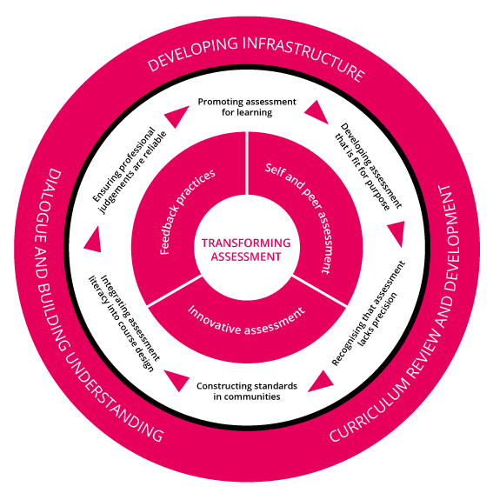
Principles for transforming assessment
Leadership and institutional strategy
Students-as-partners
Resources workload management
Staff development
Regulations and guidance
Using technology-enhanced approaches to improve assessment

Slide 28
How it works
Provides a clear structure and process to rethink and reframe assessment policy and practice.
Designed to engage and support a process of enquiry-based and evidence-informed change in practice and policy.
Offers an opportunity to reflect on what is working well and look at what needs to change in different areas of activity in order to transform understanding and practice of assessment.
Encourages open dialogue with an onus on building a shared understanding among staff, students and subject/discipline communities.

Slide 29
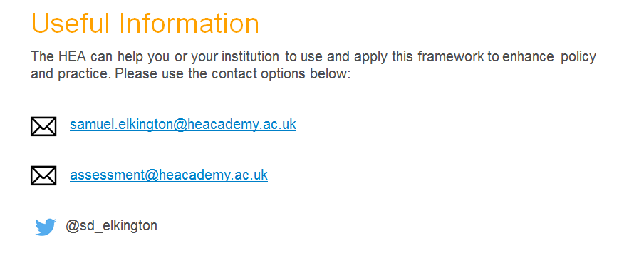
Find the Transforming Assessment Framework along with toolkits and resources here: https://www.heacademy.ac.uk/frameworks-toolkits/frameworks

Slide 30
Useful Source Material
Bloxham, S. 2012. “‘You Can See the Quality in Front of Your Eyes’: Grounding Academic Standards between Rationality and Interpretation.” Quality in Higher Education 18 (2): 185–204.
Boud, D. 2007. “Reframing Assessment as If Learning Were Important.” In Rethinking Assessment in Higher Education: Learning for the Longer Term, edited by D. Boud and N. Falchikov, 14–25. London: Routledge
Boud, D., and Associates. 2010. Assessment 2020: Seven Propositions for Assessment Reform in Higher Education. Sydney: Australian Learning and Teaching Council. http://www.iml.uts.edu.au/assessment-futures/Assessment-2020_propositions_final.pdf.
Broughan, C. and Jewell, S. 2012. “Conclusion”. In Improving student engagement and development through assessment: theory and practice in Higher Education, edited by L. Clouder, C. Broughan, S. Jewell and G. Steventon, 210-2-11. London: Routledge.
Careless, D. 2015. “Excellence in University Assessment.” London: Routledge.
Evans, C.A. 2013. “Making sense of assessment feedback in higher education.” Review of Educational Research 83 (1): 70-120.
Gibbs, G. 1999. “Using Assessment Strategically to Change the Way Students Learn.” In Assessment Matters in Higher Education, edited by S. Brown and A. Glasner, 41–54. Buckingham: Open University Press.
Hattie, J. 2009. “Visible Learning: A synthesis of over 800 meta-analyses relating to achievement”. London: Routledge.
Hounsell, D. 2007. “Towards More Sustainable Feedback to Students.” In Rethinking Assessment in Higher Education: Learning for the Longer Term, edited by D. Boud and N. Falchikov, 101–113. London: Routledge.
Kandlbinder, P., 2013. Signature concepts of key researchers in higher education teaching and learning. Teaching in Higher Education, 18(1), pp.1-12.
Medlund, E. 2016. “Assessment in Higher Education: Drivers, barriers and directions for change in the UK, Assessment & Evaluation in Higher Education, 41:1, 81-96.
Price, M., J. Carroll, B. O’Donovan, and C. Rust. 2011. “If I Was Going There I Wouldn’t Start from Here: A Critical Commentary on Current Assessment Practice.” Assessment & Evaluation in Higher Education 36 (4): 479–492.
Price, M., B. O’Donovan, C. Rust, and J. Carroll. 2008. “Assessment Standards: A Manifesto for Change.” Learning and Teaching 2 (3). http://bejlt.brookes.ac.uk/article/assessment_standards_a_manifesto_for_change/.

Slide 31
Webinar Series
Webinar Session feedback:
With thanks from your hosts
Professor Geoff Crisp, PVC Education, University of New South Wales
g.crisp[at]unsw.edu.au
Dr Mathew Hillier, Office of the Vice-Provost Learning & Teaching Monash University
mathew.hillier[at]monash.edu
Recording available
http://transformingassessment.com
e-Assessment SIG

